Slide 1
INDIAN PREMIER LEAGUE
AUCTION

Slide 2
INTRODUCTION
The Indian Premier League (IPL) is a professional Twenty20 cricket league in India, widely regarded as one of the most popular and lucrative T20 leagues globally. Launched in 2008 by the Board of Control for Cricket in India (BCCI), the IPL features franchise teams representing different cities. Known for its high-octane cricket, star-studded line-ups, and innovative formats, the IPL has become a cricketing extravaganza, attracting top international players.
With its blend of entertainment and competitive cricket, the IPL has not only revolutionized the sport but has also gained a massive fan base, making it a premier event in the cricketing calendar.

Slide 3
Create Table Query
CREATE TABLE ipl_ball (
id integer,
inning integer,
over integer,
ball integer,
batsman text,
non_striker text,
bowler text,
batsman_runs integer,
extra_runs integer,
total_runs integer,
is_wicket boolean,
dismissal_kind text,
player_dismissed text,
fielder text,
extras_type text,
batting_team text,
bowling_team text
);
CREATE TABLE IPL_matches (
id integer,
city varchar,
date date,
player_of_match varchar,
venue varchar,
neutral_venue varchar,
team1 varchar,
team2 varchar,
toss_winner varchar,
toss_decision varchar,
winner varchar,
result varchar,
result_margin varchar,
eliminator varchar,
method varchar,
umpire1 varchar,
umpire2 varchar
);

Slide 4
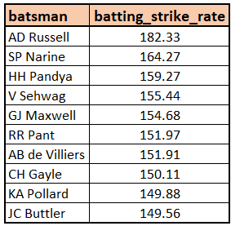
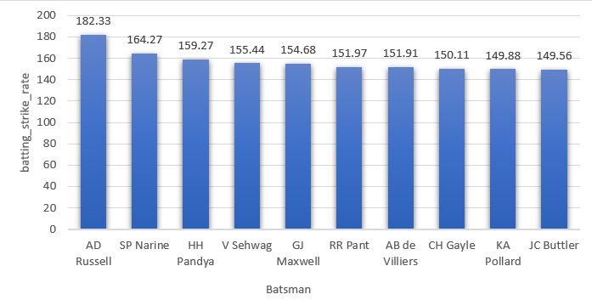
Bidding on batters
Top 10 batsmen with >500 balls faced, highest Strike Rate, bid within budget in IPL auction.
SELECT
batsman AS BATSMAN,
ROUND((SUM(batsman_runs)*1.0 / COUNT(ball)) * 100, 2) AS Batting_Strike_Rate
FROM
ipl_ball
WHERE
extras_type != 'wides'
GROUP BY
batsman
HAVING
COUNT(ball) > 500
ORDER BY
Batting_Strike_Rate DESC
LIMIT 10;

Slide 5
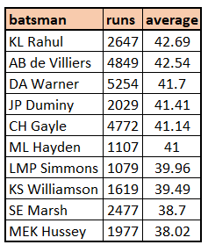
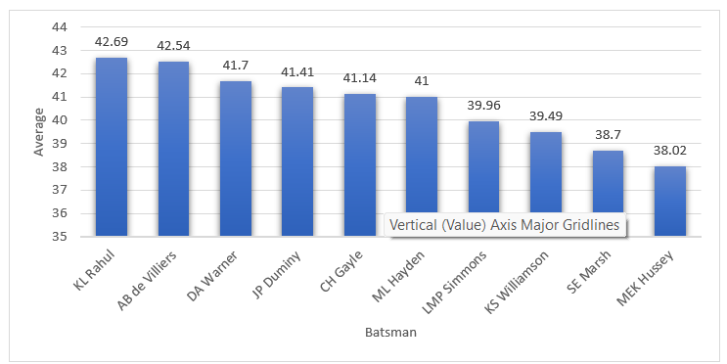
Bidding on batters
Select Top 10 consistent batsmen with high averages, played >2 IPL seasons (or 28 matches)
SELECT
batsman,
SUM(batsman_runs) AS runs,
ROUND(SUM(batsman_runs) * 1.0 / SUM(CASE WHEN is_wicket THEN 1 ELSE 0 END), 2) AS average
FROM ipl_ball
GROUP BY
batsman
HAVING
SUM(CASE WHEN is_wicket THEN 1 ELSE 0 END) > 0
AND COUNT(DISTINCT id) > 28
ORDER BY
average DESC
LIMIT 10;

Slide 6
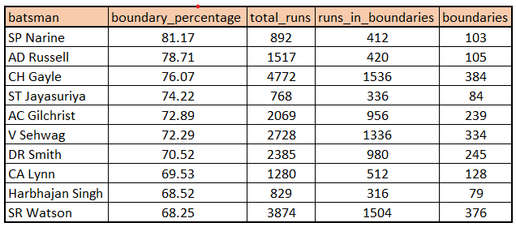
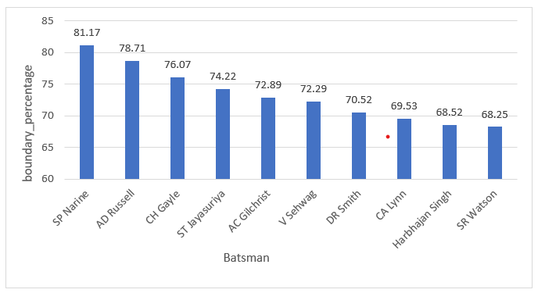
Bidding on batters
Select Top 10 players who have scored most runs in boundaries and have played more than 2 IPL seasons(more than 28 matches).
SELECT
batsman,
ROUND(SUM(CASE WHEN batsman_runs IN (4, 6) THEN batsman_runs ELSE 0 END) * 1.0 / SUM(batsman_runs) * 100, 2) AS boundary_percentage,
SUM(batsman_runs) AS total_runs,
SUM(CASE WHEN batsman_runs IN (4) THEN batsman_runs ELSE 0 END) AS runs_in_boundaries,
COUNT(CASE WHEN batsman_runs IN (4) THEN 1 END) AS boundaries
FROM ipl_ball
WHERE extras_type NOT IN ('wides')
GROUP BY
batsman
HAVING
COUNT(DISTINCT id) > 28
ORDER BY
boundary_percentage DESC
LIMIT 10;

Slide 7
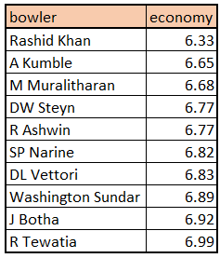
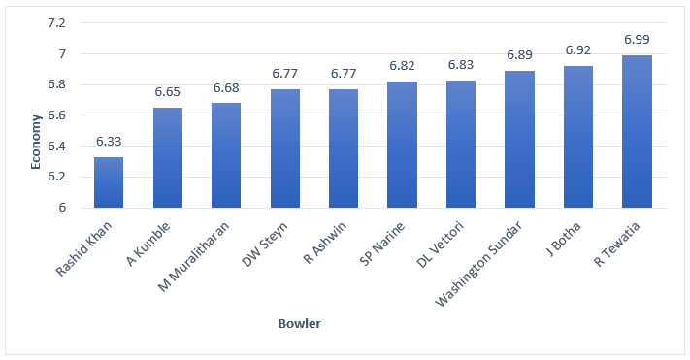
Bidding on Bowlers
Select Top 10 bowlers with best economy who have bowled at least 500 balls in IPL
SELECT
bowler,
ROUND(SUM(total_runs)/(COUNT(bowler)/6.0), 2)
as economy
FROM ipl_ball
GROUP BY
bowler
HAVING
COUNT(bowler) > 500
ORDER BY
economy
LIMIT 10;

Slide 8
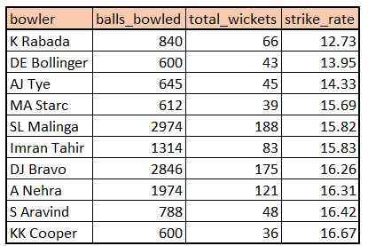
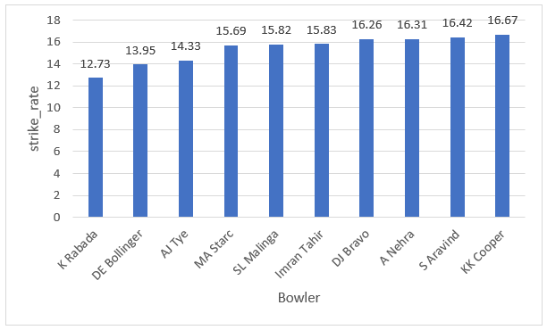
Bidding on Bowlers
Select Top 10 bowlers who have the best strike rate and who gave bowled at least 500 balls
WITH BowlerStats AS (
SELECT
bowler,
COUNT(*) AS balls_bowled,
SUM(CASE WHEN is_wicket THEN 1 ELSE 0 END) AS total_wickets
FROM
ipl_ball
GROUP BY
bowler
HAVING
COUNT(*) >= 500
)
SELECT
bowler,
balls_bowled,
total_wickets,
ROUND(balls_bowled * 1.0 / NULLIF(total_wickets, 0), 2) AS strike_rate
FROM
BowlerStats
ORDER BY
strike_rate
LIMIT 10;

Slide 9
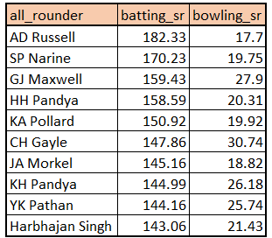
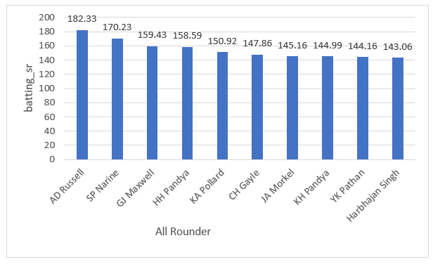
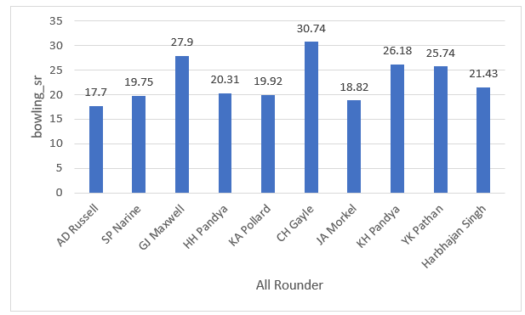
Bidding on All-Rounders
List of 10 allrounders who have the best bowling and batting strike rate and who gave faced at least 500 balls and bowled at least 300 balls.
CREATE TABLE IF NOT EXISTS bowling_sr AS ( WITH BowlerStats AS ( SELECT bowler, COUNT(*) AS balls_bowled, SUM(CASE WHEN is_wicket THEN 1 ELSE 0 END) AS total_wickets FROM ipl_ball GROUP BY bowler HAVING COUNT(*) >= 300 ) SELECT bowler, balls_bowled, total_wickets, ROUND(balls_bowled * 1.0 / NULLIF(total_wickets, 0), 2) AS strike_rate FROM BowlerStats ); | CREATE INDEX IF NOT EXISTS idx_bowler ON bowling_sr(bowler); CREATE TABLE IF NOT EXISTS batting_sr AS ( WITH BatsmanStats AS ( SELECT batsman, COUNT(*) AS balls_faced, SUM(batsman_runs) AS total_runs, ROUND(SUM(batsman_runs) * 100.0 / COUNT(*), 2) AS batting_sr FROM ipl_ball WHERE is_wicket = FALSE GROUP BY batsman HAVING COUNT(*) >= 500 ) SELECT * FROM BatsmanStats ); | CREATE INDEX IF NOT EXISTS idx_batsman ON batting_sr(batsman); SELECT a.batsman AS all_rounder, a.batting_sr, b.strike_rate AS bowling_sr FROM batting_sr a INNER JOIN bowling_sr b ON a.batsman = b.bowler ORDER BY a.batting_sr DESC, b.strike_rate ASC LIMIT 10;

Slide 10
The most important criteria for selecting wicketkeepers in the IPL
Batting Ability: Prioritize wicketkeepers who can score quickly and consistently, capable of hitting boundaries and contributing significantly to the team's run total.
Agility and Glovework: Strong wicketkeeping skills are vital. Look for wicketkeepers with quick reflexes, clean catching ability, and accurate stumpings, enhancing the team's fielding efforts.
Experience: Consider wicketkeepers with prior T20 experience, as they are more likely to handle pressure situations effectively and make informed decisions on the field.
Versatility: Choose wicketkeepers who can adapt to different match scenarios and contribute effectively in various batting positions, providing flexibility to the team's lineup.
Leadership and Communication: Wicketkeepers who can lead the fielding unit, provide strategic input, and effectively communicate with bowlers and fielders are invaluable assets to the team's dynamics.
Fielding: Prioritize wicketkeepers with excellent fielding skills, capable of creating run-out opportunities and contributing to the team's overall fielding performance.
Consistency: Look for wicketkeepers with a proven track record of consistent performance, both in batting and wicketkeeping, ensuring stable contributions throughout the tournament and bolstering the team's reliability.

Slide 11
Additional Questions

Slide 12
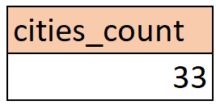
1] Get the count of cities that have hosted an IPL match
SELECT COUNT(DISTINCT city) AS cities_count
FROM ipl_matches;

Slide 13
2] Create table deliveries_v02 with all the columns of the table ‘deliveries’ and an additional column ball_result containing values boundary, dot or other depending on the total_run (boundary for >= 4, dot for 0 and other for any other number)
CREATE TABLE deliveries_v02 AS
SELECT *,
CASE
WHEN total_runs >= 4 THEN 'boundary'
WHEN total_runs = 0 THEN 'dot'
ELSE 'other'
END AS ball_result
FROM ipl_ball;

Slide 14
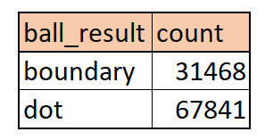
3] Write a query to fetch the total number of boundaries and dot balls from the deliveries_v02 table
SELECT
ball_result,
COUNT(*) AS count
FROM
deliveries_v02
WHERE
ball_result IN ('boundary', 'dot')
GROUP BY
ball_result;

Slide 15
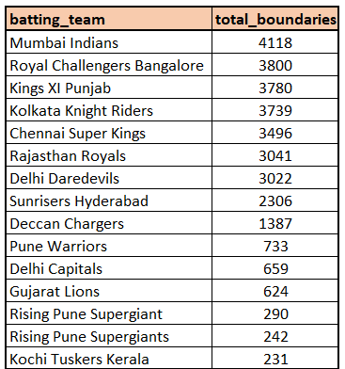
4] Write a query to fetch the total number of boundaries scored by each team from the deliveries_v02 table and order it in descending order of the number of boundaries scored
SELECT
batting_team,
COUNT(*) AS total_boundaries
FROM
deliveries_v02
WHERE
ball_result = 'boundary'
GROUP BY
batting_team
ORDER BY
total_boundaries DESC;

Slide 16
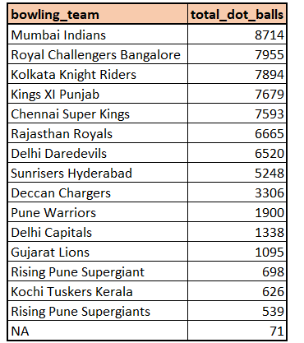
5] Write a query to fetch the total number of dot balls bowled by each team and order it in descending order of the total number of dot balls bowled
SELECT
bowling_team,
COUNT(*) AS total_dot_balls
FROM deliveries_v02
WHERE ball_result = 'dot'
GROUP BY
bowling_team
ORDER BY
total_dot_balls DESC;

Slide 17

6] Write a query to fetch the total number of dismissals by dismissal kinds where dismissal kind is not NA
SELECT
SUM(COUNT(*)) OVER () AS total_dismissal
FROM
ipl_ball
WHERE
dismissal_kind != 'NA';

Slide 18
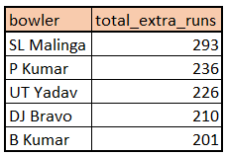
7] Write a query to get the top 5 bowlers who conceded maximum extra runs from the deliveries table
SELECT
bowler,
SUM(extra_runs) AS total_extra_runs
FROM
deliveries_v02
GROUP BY
bowler
ORDER BY
total_extra_runs DESC
LIMIT 5;

Slide 19
8] Write a query to create a table named deliveries_v03 with all the columns of deliveries_v02 table and two additional column (named venue and match_date) of venue and date from table matches
CREATE TABLE deliveries_v03 AS
SELECT d.*, m.venue, m.date AS match_date
FROM deliveries_v02 AS d
JOIN ipl_matches AS m ON d.id = m.id;

Slide 20
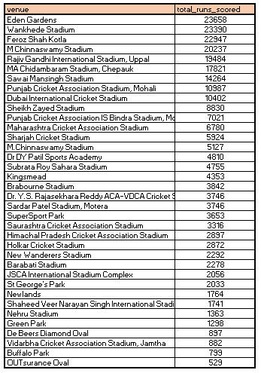
9] Write a query to fetch the total runs scored for each venue and order it in the descending order of total runs scored.
SELECT
venue,
SUM(total_runs) AS total_runs_scored
FROM
deliveries_v03
GROUP BY
venue
ORDER BY
total_runs_scored DESC;

Slide 21
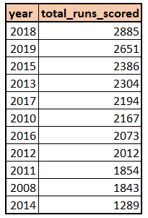
10] Write a query to fetch the year-wise total runs scored at Eden Gardens and order it in the descending order of total runs scored.
SELECT
EXTRACT(YEAR FROM match_date) AS year,
SUM(total_runs) AS total_runs_scored
FROM
deliveries_v03
WHERE
venue = 'Eden Gardens'
GROUP BY
year
ORDER BY
total_runs_scored DESC;

Slide 22
THANK YOU

